Slide 1
How to Use this Presentation Template
  Feel free to use these slides, or copy/paste certain content and images into your company’s PPT template.
  Current values (hours and rate) are based on placeholder averages in calculator worksheet. You can adjust the numbers on hours and hourly rate accordingly based on your own data.
  If you’re unsure of hours to complete a task, the placeholder hours represent the typical hours taken by professionals responsible for training in food and manufacturing facilities.
    We based these placeholders using decades of industry experience and conversations with thousands of thousands of manufacturing professionals responsible for training
    Note: the hours Intertek Alchemy spends on similar tasks is much higher; it is Alchemy’s sole job to develop the courses with sophisticated equipment and staff to produce the highest quality courseware.
  The “Force Multiplier” values (e.g., # of employees, # of facilities) can also be adjust to more accurately reflect your operations.
  If you would like more materials or have any question, please email ContactUs@IntertekAlchemy.com.

Slide 2

Make a Game Plan to Present Business Case for Resources
  Get other departments involved early; training is everyone’s responsibility
  Educate leadership on all the steps and skill sets required; use this template to get started
  Demonstrate the time each step takes
  Pin a dollar amount to this time
  Include force multipliers: # of employees, facilities, etc.
  Include a quantitative and qualitative comparison
  Outline what else you could achieve with freed-up time
    Work on job-specific training
    Develop or enhance learning plans (by role)
    Leadership development & succession planning
    Culture

Slide 3

Calculating the Hidden Costs of Training Development

Slide 4
Agenda
1
Training & Course Development
4
Training Management & Workforce Development
2
Training Facilitation
5
Recap & Resources
3
Audit Preparation

Slide 5
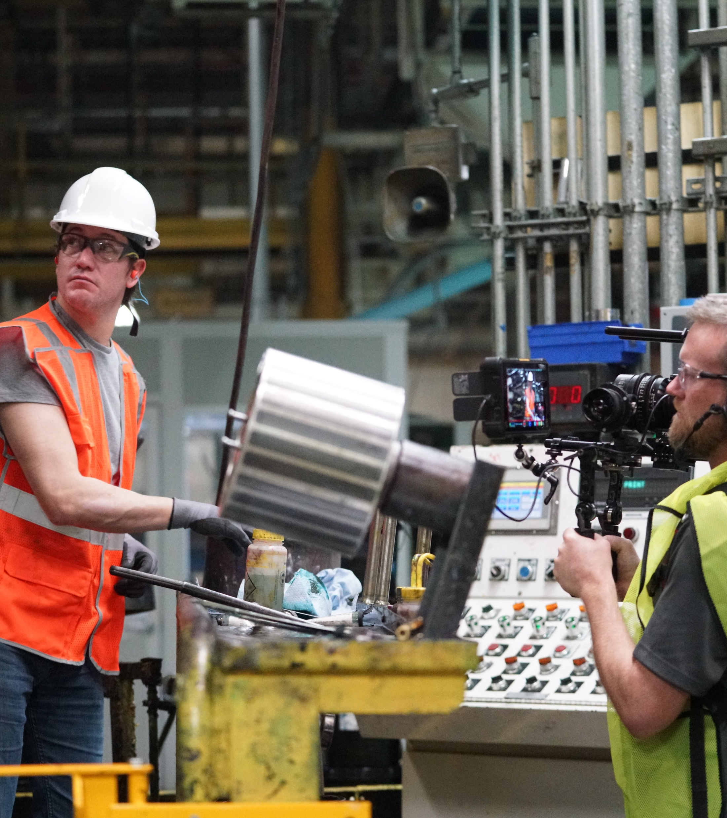
Training & Course Development

Slide 6
Creating Courses – More than Meets the Eye
Task
Hours
43 Hours
$800 – $1,200
(for 1 course)
Course/script writing (includes research, SME review, etc.)
16
Ensuring adherence to regulatory requirements
1
Photography and/or graphic creation
3
Video production and file prep
5
Voice over
2
Course assembly (PPT or other software)
8
Language translation (VO, graphics, slide content, adding
8
subtitles)
–
includes time of worker needed to translate

Slide 7

Creating Courses – Force Multipliers
One course = 43 hours to develop
24 courses = 1,032 hours to develop
Updates and edits to keep current: 103 hours
$ 1,000
$24,000
$ 2,400
TOTAL $27,400
Facilities developing training independently
x 4 = $109,600

Slide 8

Creating Courses – Skillset & Knowledge Required
  Subject matter expertise – wide range of topics
    From bloodborne pathogens, to working at height, to Family Medical Leave Act, to HACCP, to…
  Adult learning science
    Words-to-image ratios; storyline development; maintaining learner engagement; repetition strategies; remediation tactics
  Photography, photo editing
  Videography, video editing
  Graphic design
  Voiceover, audio editing
  Regulatory code and content requirements –
  wide range of topics

Slide 9
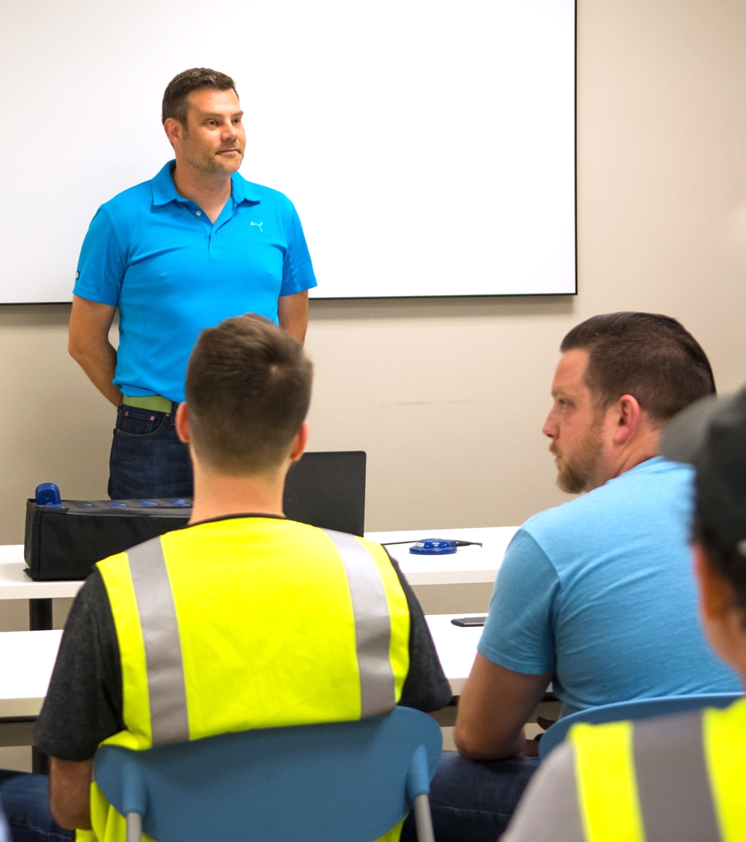
Training
Facilitation

Slide 10

Training Facilitation – Facilitate the Facilitators
Task | Hours
Training for facilitator to give accurate & consistent training | 1
Documenting training attendance for 25 employees | 0.5
Grading and tracking quiz/assessments of 25 employees | 2
3.5 Hours
$70 – $100
(for 25 employees)
Force multiplier: 250 employees
Force multiplier: 24 courses
x 10 = $850
x 24 = $20,400

Slide 11
Training Facilitation – Skillset & Knowledge Required
  Understanding of training content
  Teaching skills
  Soft skills
    Keeping employees engaged, attentive
  Audio/visual & technology expertise
  Data entry (error free)
  Grading (error free)

Slide 12
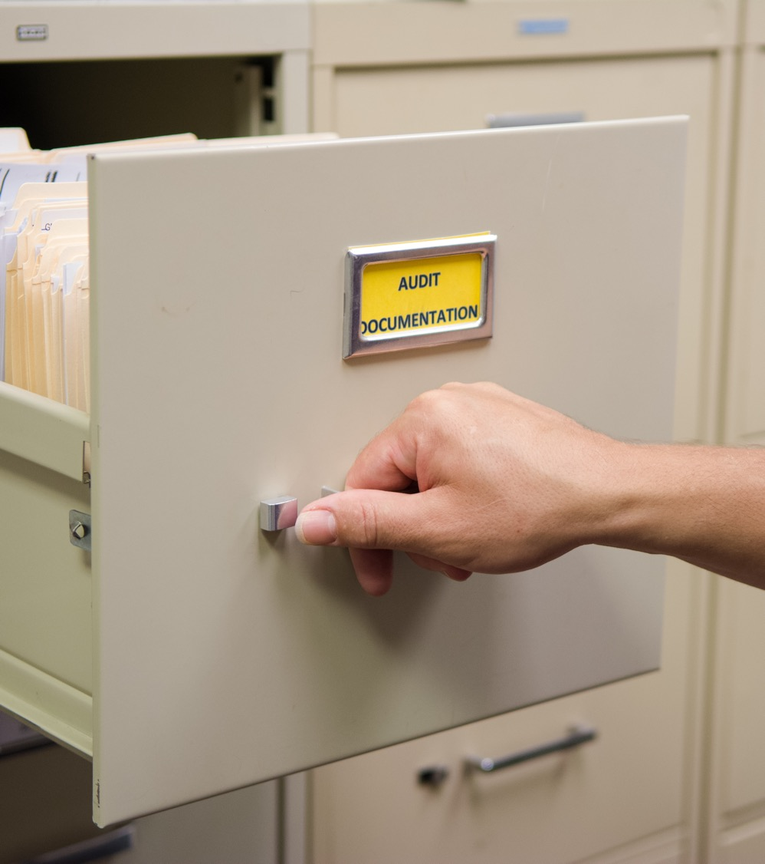
Audit
Preparation

Slide 13

Audit Preparation – So many training records, soooo many
Task | Hours
Retrieving and organizing all employee training records | 20
Correcting and tracking down lost training records | 40
Walking auditor through training records | 1
61 Hours
$1,200 - $1,800
(for a single audit)
Force multiplier: 4 audits per year
x 4 = $6,000

Slide 14
Audit Preparation – Skillset & Knowledge Required
  Process expertise
  Records research
  Data entry
  Patience, extreme patience

Slide 15
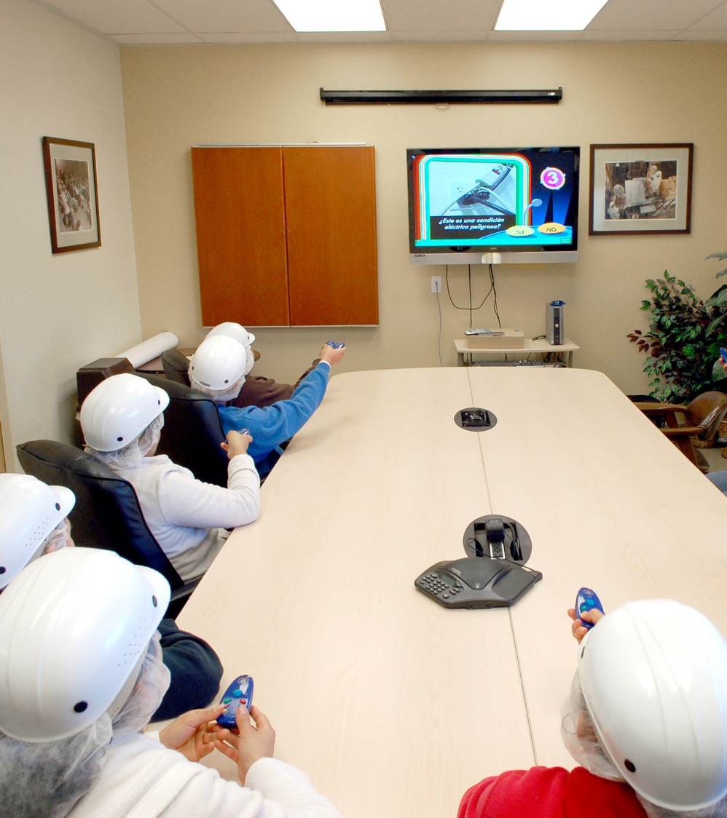
Training Management & Workforce Development

Slide 16



The Business Case for Workforce Development
94% of employees say they would stay at their company longer if it invested in their learning and development.¹
Studies show companies with better training and workforce development experience²:
15%
26%
20%
65%
Greater
Employee
Productivity
Less
Employee
Turnover
Less
Employee
Absenteeism
Greater
Share Price Increase
Sources: ¹LinkedIn Learning; ²“Global Trends in Employee Engagement” (North American results cited ), Aon Hewitt/Queens University
Notes:
The annual study first polls employees at 200 companies to measure employee engagement levels, then compares the performance of companies with high employee engagement compared to companies with low employee engagement.
This annual study also finds companies with most engaged employees achieve 30% greater customer satisfaction.

Slide 17



Training Management & Workforce Development
Task | Hours (annual)
Developing and implementing role-specific learning plans | 20
Review of records to find employees missing required training | 20
Review of records to find employees struggling with training | 20
Tracking/reporting training activity for internal reporting | 24
84 Hours
$1,700 - $2,500
(annually, 1 facility)
Creating leadership development program
= $20,000

Slide 18
Workforce Development – Skills & Knowledge Required
  Process expertise
  Adult learning strategies
  Leadership development
  Mentoring
  Generational & cultural differences
  Succession planning
  Workforce of the future

Slide 19
Recap & Resources

Slide 20
$158,050
Cost of training not captured on budget line items
Notes:
Adding up the totals from the previous sections of this presentation.

Slide 21
Recap of the Hats to Wear
  Subject matter expertise – wide range
  of topics
  Adult learning science
  Photography, photo editing
  Videography, video editing
  Graphic design
  Voiceover, audio editing
  Regulatory code and content requirements
  Teaching skills
  Soft skills
  Audio/visual & technology expertise
  Data entry (error free)
  Grading (error free)
  Process expertise
  Records research
  Patience, extreme patience
  Adult learning strategies
  Leadership development
  Mentoring
  Generational & cultural differences
  Succession planning
  Workforce of the future

Slide 22
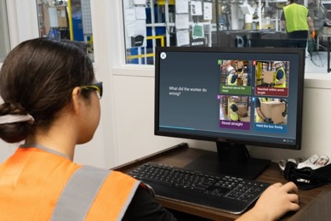
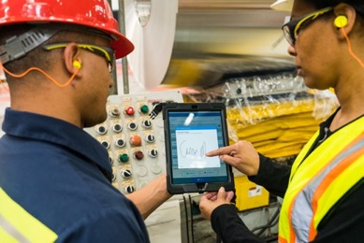


Boost Your Training Programs with Intertek Alchemy
Training
Hundreds of multi-lingual courses
Flexible platform: eLearning, group training, and OJT
Easily customizable content
Reinforcement
App for on-the-floor observations
Training-coordinated signage
Supervisor guides for consistency
Compliance
Automated recordkeeping
Paperless documentation
Audit-ready reporting
trusted by
1,500
clients
at over
7,500
facilities
engaging
1,000,000
frontline production workers

